Slide 1
Rubrics Revisited
Faculty Development

Slide 2
Notes:
DAPHNA
https://library.gwu.edu/teaching-day
https://forms.gle/Cdrs7MaPWziN66o29 (register!)

Slide 3
Faculty Development Staff
Daphna Atias
Robin Pokorski
Caitlin Savoldelli
Educational Developer
datias@gwu.edu
Educational Developer and Interim Director
pokorski@gwu.edu
Accessibility Instructional Designer
cbcrain@gwu.edu
Notes:
DAPHNA

Slide 4
Today’s Agenda
What makes a successful rubric?: Case studies
[Section 3]
Work time!
[Section 4]
Notes:
ROBIN

Slide 5
What makes a successful rubric?: Case studies
Notes:
ROBIN

Slide 6
Rubrics are primarily a communication device.
Notes:
ROBIN
They serve to communicate your expectations and standards for an assignment to students. They do not require you to lower your standards: simply to make them readily apparent to your students.

Slide 7
Four main types of rubrics
Analytic → This is what you likely think of when you think of a rubric! Table-style
Holistic All characteristics of a level described together
Checklist Yes-or-no decisions for criteria
Single-point Describes the “meeting expectations” level
Notes:
ROBIN
There are four main types of rubrics—I will show you an example of each in a moment, but I wanted to begin by introducing all four types. They are:
The analytic or chart-style rubric—this is likely what you are thinking of when you hear the word “rubric”, and it will be the focus of our brainstorming in the final part of the workshop
The holistic rubric, that describes all characteristics required to meet a level of performance;
The checklist, which presents yes or no decisions for different criteria;
And the single-point rubric, which describes the mid-level while allowing you to identify aspects of the assignment that are exceeding or not yet meeting expectations
These types can be combined, too--in a bit, we’ll show an example of how we did that.

Slide 8
What type of rubric is best?
Levels of performance: What are students achieving?
Criteria: What are you assessing?
Relative weight: How important is each criterion?
Notes:
ROBIN
As you think about your assignment, three categories might help you decide what type of rubric will work best and how much specificity it needs.
First, think about the columns on an analytic rubric. How many different levels of performance are needed to differentiate between strong and progressing work? A checklist or single-point rubric may be more appropriate if work can easily be classified as “proficient” or “not there yet,” while analytic and holistic rubrics provide more dimensions along which to categorize
Next, think about what you are looking for as you assess students’ work. Each criterion can be a row in an analytic rubric, a descriptor in a holistic rubric, or an item in a checklist.
Finally, think about how categories are weighted. Is every dimension as important as every other dimension? If so, a holistic, checklist, or single-point rubric may work best. An analytic rubric, on the other hand, may be the best tool for assigning different levels of importance to different categories. One area where this surfaces is in assessing students’ grammar, mechanics, and citational practices. These are important skills, but for most assignments, correct grammar is not as important as, for example, a strong argument or effective use of evidence. An analytic rubric that includes grammar and mechanics but weighs them lower than other categories can help you convey which skills are most significant for students to practice.

Slide 9
What makes for a “good” rubric?
Notes:
DAPHNA
NExt additional Q: Is a “good” rubric different from the faculty perspective and the student perspective?

Slide 10
What makes for a “good” rubric?
Clear
Precise
Useable
Useful
Notes:
DAPHNA

Slide 11
Is what makes a “good” rubric different from the faculty perspective and the student perspective?
Notes:
DAPHNA
Potential additional Q: Is a “good” rubric different from the faculty perspective and the student perspective?

Slide 12
How can you use rubrics with students?
Co-create the rubric with students
Gather student input on the rubric itself
Practice applying the rubric together to a sample assignment
Use the rubric for self- or peer assessment
Notes:
DAPHNA
Co-create the rubric with students
What criteria for success would they include? How would they weight it?
Gather student input on the rubric itself
Do they think it captures the learning goals for the assignment? What might they add or change?
Practice applying the rubric together to a sample assignment
Use the rubric for self- or peer assessment
Scaffold in a step where students review their own work or each others’ work using the rubric. This can refine their materials without adding additional labor for you!

Slide 13
Three case studies!
Notes:
We want to take a look at some case studies to help spark some thoughts about what makes a rubric that

Slide 14
Case study #1: Context
Holistic rubric
For a term paper
Notes:
ROBIN

Slide 15
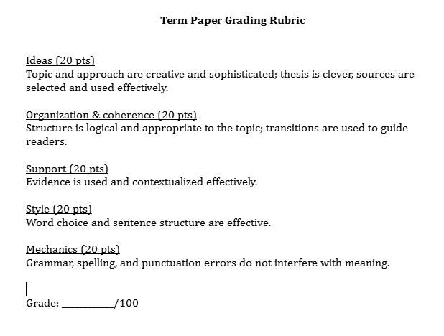
Case study #1: The rubric
Notes:
ROBIN
[[include as image on the slide]]

Slide 16
Reflect on this rubric
What does this rubric do well?
What does this rubric do less well?
https://tinyurl.com/SPHrubrics
Notes:
DAPHNA
Daphna introduces Ideaboard and facilitates the discussion
This will take you to Ideaboard--a very simple tool that several of you have used before.
For now, we’ll focus on the two questions on the top half of the board--you can enter your own thoughts, and you can use the +1 button in the lefthand corner of each note to upvote reflections from others that you agree with

Slide 17
Discussion
What are themes that arose on the IdeaBoard about what this rubric does well and less well?
What is one step you would take to begin to revise this rubric?
Notes:
DAPHNA

Slide 18
Case study #2: Context
Analytic rubric
For a paper assignment
Notes:
DAPHNA
[[include as image on the slide]]

Slide 19
Case study #2: The rubric
Sent as a PDF file in the chat
Take a moment to skim over the complete rubric
Notes:
DAPHNA
[[include as image on the slide]]

Slide 20
Reflect on this rubric
What does this rubric do well?
What does this rubric do less well?
https://tinyurl.com/SPHrubrics
Notes:
ROBIN
We’d like to send you back to the same IdeaBoard now to share some thoughts!

Slide 21
Discussion
What are themes that arose on the IdeaBoard about what this rubric does well and less well?
What differences do you see between the two case studies?
What is one step you would take to begin to revise this rubric?
Notes:
ROBIN

Slide 22
Case study #3: Context
Created by MaryBeth Musumeci in Public Health
Undergraduate course
Assignment: design your own healthcare organization and describe it in a pro forma report
Notes:
DAPHNA
So far, we’ve had you think about how to solve rubric problems. We want to show you an example of how we did it, partly because it’s from Public Health, and partly because we are very proud of the work we did on this, so we want to brag
The assignment had a very specific format that students needed to follow. Part of the challenge was following the specific format well, and another part was including the required information within that format.
We will first show you the starting point, and then where the rubric landed.

Slide 23
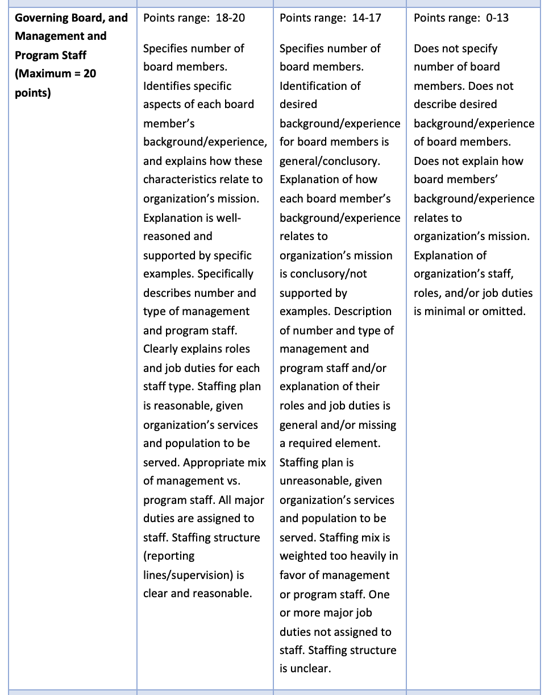
Case study #3:
The original rubric
Notes:
DAPHNA

Slide 24
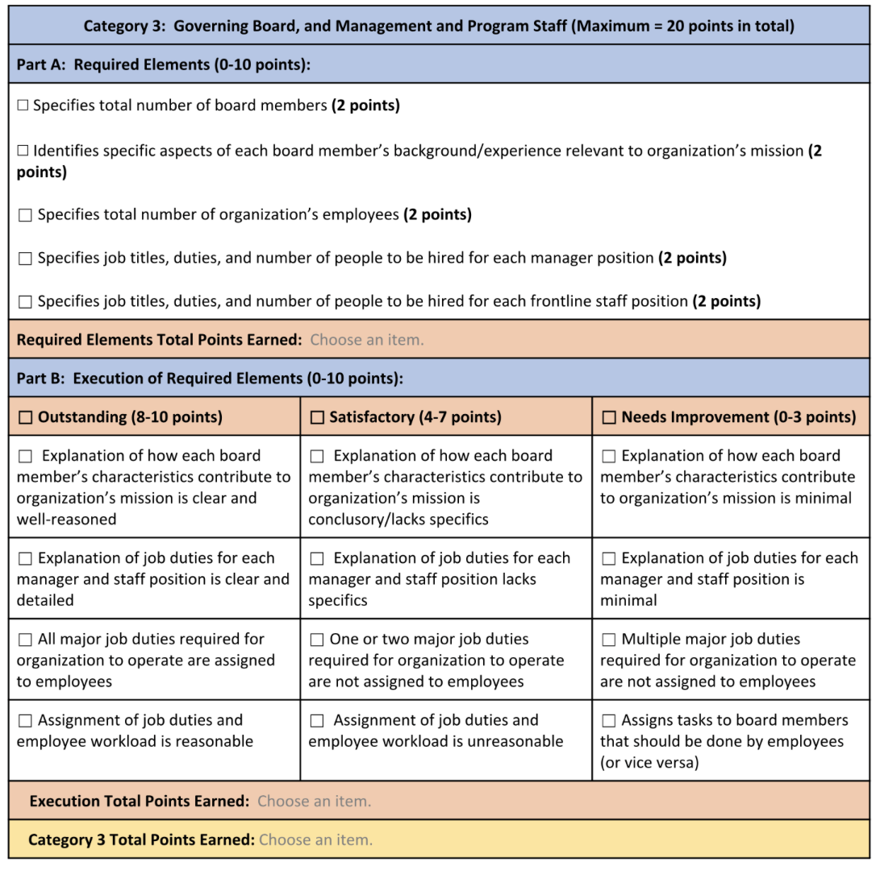
Case study #3:
The revised rubric
Graded in individual Word documents, saved as PDF, uploaded to Blackboard or
Uploaded into Blackboard (minus individual checkboxes for execution categories)
Notes:
DAPHNA
This rubric was trying to do two things. It was trying to serve as a checklist of required components and as an assessment of proficiency for those components where you didn’t just have to include some information, you had to explain it or make decisions and allocations

Slide 25
Case study #3: The revised rubric
Notes:
DAPHNA
So, we decided to split up that functionality in allocating the points. For Part A, all you need to do is include the information

Slide 26
Case study #3: The revised rubric
Notes:
DAPHNA
For Part B, there is an execution score
So, In Blackboard, the checkboxes for outstanding, satisfactory, and needs improvement appear, but not the individual checkboxes under each.

Slide 27
How did this go?
“I used it last semester for grading, and it was wonderful!”
Students used truncated version of the rubric as worksheets to dos hort peer review assignments
Small-scale revisions
“I already used it to grade one assignment, and I love it so much!”
Notes:
DAPHNA

Slide 28
In short: How can you make the rubric work for you, your students, and your assignment?
Notes:
ROBIN

Slide 29
Questions?
Notes:
ROBIN asks if there are any questions; DAPHNA & ROBIN field questions together

Slide 30
Work time!
Notes:
ROBIN

Slide 31
Two options:
You will choose and you can swap as you would like!
Breakout room: Silent work time
Main room: Open office hours
Ask a question: creating, editing, or implementing a rubric
Listen to the conversation
Want to team up with someone? We can create additional rooms!
Notes:
ROBIN

