Slide 1
PhD Information Session Summer 2023
Office of PhD/MS Programs

Slide 2
Agenda
Overview of PhD Programs - Dr. Lorien Abroms
Health Policy PhD Program - Dr. Leighton Ku
Student Perspective - Lauren O’Connor
Admissions - Tricia Realbuto

Slide 3
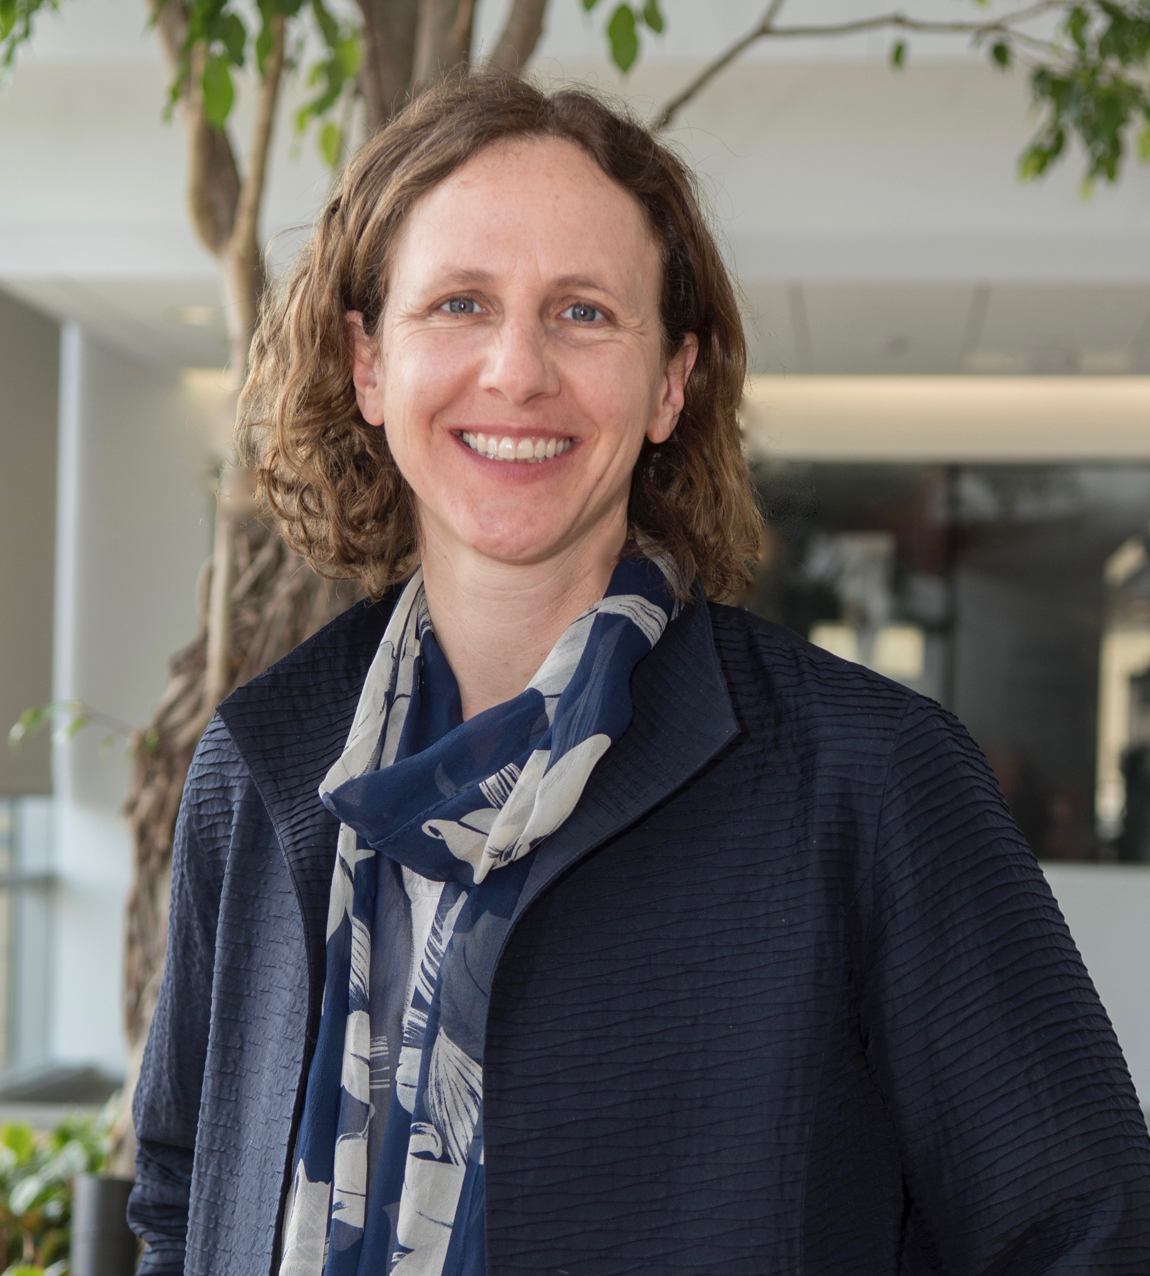
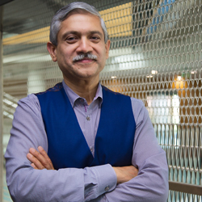
Leadership
Dr. Lorien Abroms
Associate Dean for PhD/MS Programs
Professor of Prevention and Community Health
Lorien@gwu.edu
Dr. Adnan Hyder
Senior Associate Dean for Research
Professor of Global Health
Office of PhD/MS Programs

Slide 4
Overview of PhD Programs

Slide 5
What is research?

Slide 6
What is a Research Career?
Pursuit of new knowledge, discovery, and dissemination of that new knowledge
Lead or participate in design studies, conduct studies, share findings
Collect and analyze data
Quantitative or qualitative
Share findings by writing papers, books, making presentations at conferences, talking to the news….
Expertise in one specific topic and/or method
Teach/mentor new students
Service to the field and discipline specific associations
It is fun and a privilege to be the expert, to have independence to pick area of focus, to do this valuable work.

Slide 7
What can a research career look like?
MPH/MS (2 years)
PhD Student (4-5 years)
Postdoctoral Fellow (2 years)
Enter one of several settings
Academia: assistant/associate/full professor
Government
Industry/Consulting
Non-Profit
Health Care

Slide 8
Krasna H. (2019). Employment Trends Among Public Health Doctoral Graduates. American journal of public health, 109(4), e9. https://doi.org/10.2105/AJPH.2019.304966
Notes:
Brown-Podgorski BL, Holmes AM, Golembiewski EH, Jackson JR, Menachemi N. Employment Trends Among Public Health Doctoral Recipients, 2003-2015. Am J Public Health. 2018;108(9):1171-1177. doi:10.2105/AJPH.2018.304553
Updated: Krasna H. (2019). Employment Trends Among Public Health Doctoral Graduates. American journal of public health, 109(4), e9. https://doi.org/10.2105/AJPH.2019.304966

Slide 9
GWSPH DOCTORAL OUTCOMES SNAPSHOT
Professor
Assistant Professor
Director of Policy
Senior Research Leader
Epidemiologist
Environmental Scientist
Evaluation Fellow
Post Doctoral Fellow
Public Health Consultant
Director of Health Policy
50%
Non Profit
$100,000
Average Salary upon Graduation
50%
Public or Government

Slide 10
SAMPLE LIST OF DOCTORAL CAREER OPTIONS
Associate Professor/Chair of Public Health
PhD Level Policy Analyst
PhD Level Surveillance Epidemiologist
Public Health Prevention Researcher
Health Scientist/Bioinformatician
Health Commissioner
Senior Clinical Research Analyst
Director in an Office of Health Equity
Toxicologist
Senior Director Emerging Infectious Diseases and Vaccines
Monitoring, Evaluation, Research, and Learning Director
Principal Investigator in a Lab Setting
Health Economist
Vaccine Researcher
Implementation Scientist
Behavioral Scientist
Researcher in Aging and Public Health
Disaster Preparedness Researcher
Biodefense Researcher
Mental Health Researcher
Federal Agency Director

Slide 11
PhD Graduate: Sukyoung Jung
Current position:
Research Professor, Chungnam National University Hospital Biomedical Research Institute (South Korea)
PhD in Epidemiology
Research on sustainable diet and obesity
In her dissertation, she used nationally representative data to develop a sustainable diet index for US adults, characterize its trends over time, and examine the associations with obesity and mortality.

Slide 12
PhD Graduate: Shaon Lahiri
Current position:
Postdoctoral fellow, University of Pennsylvania
PhD in Social and Behavior Sciences
Research examines the role of social norms and health behaviors
dissertation focused on understanding the relationship between social norms change and tobacco use in Mainland China

Slide 13
Reasons to Consider sticking with the MPH/MS
You already know a lot and are employable! Might not need the degree and can have a great productive career.
Being a student is a lot of work and is expensive: lost earnings, costs incurred beyond those covered by PhD Fellowship
Limited slots: It’s competitive and you might not get in
Once get a job, you under pressure to raise funds and do research; more hard work!

Slide 14
Reasons to Consider DrPH Programs (vs PhD)
DrPH Program: This is an interdisciplinary, public health leadership training program that delivers practice-based curriculum and applied research to equip public health leaders with skills for the development, implementation, and evaluation of public health programs and policies.
Requires work experience (5 years)
Examples: Federal Agency Director; Director of Health Equity
Director: Gene Migliaccio, DrPH
Email: geno@gwu.edu

Slide 16
GWSPH PhD Programs & Program Directors
1) Health Data Science
Dr. Keith Crandall
Dr. Guoqing Diao
Dr. Toshi Hamasaki
2) Global Public Health Sciences
3) Social and Behavioral Sciences
Dr. Nirbhay Kumar
Dr. Carlos Rodriguez-Diaz

Slide 17
GWSPH PhD Programs & Program Directors
4) Environmental & Occupational Health
5) Epidemiology
Dr. Lance Price
Dr. Kate Applebaum
Dr. Heather Young
6) Health Policy
7) Exercise Physiology
& Applied Nutrition
Dr. Leighton Ku
Dr. Avi Dor
Dr. Jennifer Sacheck

Slide 18
PhD Core Classes
Core Discipline | Core Class
Current topics and debates in public health | PUBH 8001 PhD Seminar: Cross Cutting Concepts in Public Health (1 credit)
Responsible conduct of research/ethics | PUBH 6421 Responsible Conduct of Research (1 credit) or PUBH 8475 Ethics in Domestic and International Research (2 credits)
Statistical methods | PUBH 8418 Applied Statistical Analysis or PUBH 6862 Applied Linear Regression Analysis for Public Health (3 credits)
Design of Health Studies | PUBH 8416 Study Design and Evaluation Methods or PUBH 6495 Field Trial Methods and Application, with (1 additional credit) (3 credits) PUBH 6247 Design of Health Studies (3 credits)
Grant and proposal writing | PUBHH 8435 PhD Dissertation Proposal Development (2 credits)
Core Discipline | Core Class Title
Current Topics and Debates in Public Health | PUBH 8001: PhD Seminar: Cross Cutting Concepts in Public Health (1 credit)
Responsible Conduct of Research/Ethics | PUBH 6421: Responsible Conduct of Research (1 credit)
Statistical Methods | PUBH 8418: Applied Statistical Analysis or PUBH 6862: Applied Linear Regression Analysis for Public Health (3 credits)
Design of Health Studies | PUBH 8416: Study Design and Evaluation Methods or PUBH 6495: Field Trial Methods and Application, with (1 additional credit) (3 credits) PUBH 6247: Design of Health Studies (3 credits)
Grant and Proposal Writing | PUBH 8435: PhD Proposal Development (2 credits)

Slide 19
Advising
You will have a primary advisor
Advisors guide in the selection of coursework, research opportunities, professional/leadership development, dissertation research topics, the selection of the dissertation committee members…
Regular meetings (1/semester early on; weekly in later stages)
Advise on annual objectives and timeline for program completion

Slide 20
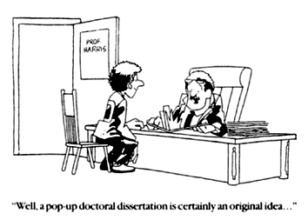
Innovation is good but…

Slide 21
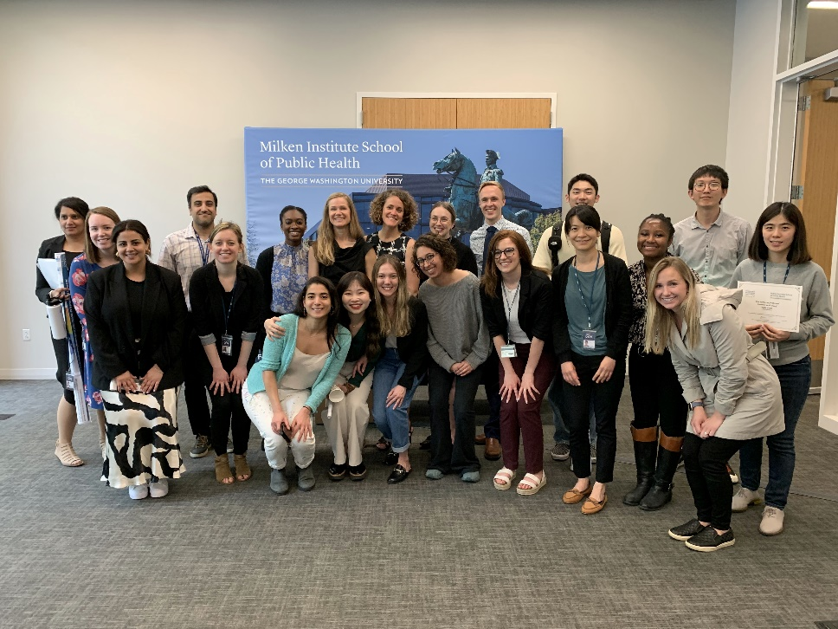
Our PhD Students
83 total PhD students
71% female
29% male
49% White
38% Asian
5% Black
1% Hispanic
6% Two or more races

Slide 22
Funding your PhD
GWSPH Funding Packages
Tuition + research assistantship
Tuition + stipend + teaching assistant/research assistantship
Specialized topics:
NIH T32 : Social-Structural Factors Related to HIV Intersectionality (TASHI)
Redstone Center Prevention & Wellness (obesity/physical activity)
Commercial Determinants of Health
Other Funding
- Gates Foundation
- GW tuition benefits
- NIH/National Research Service Award Fellowships (F31)

Slide 23
Health Policy PhD Program
Dr. Leighton Ku

Slide 24
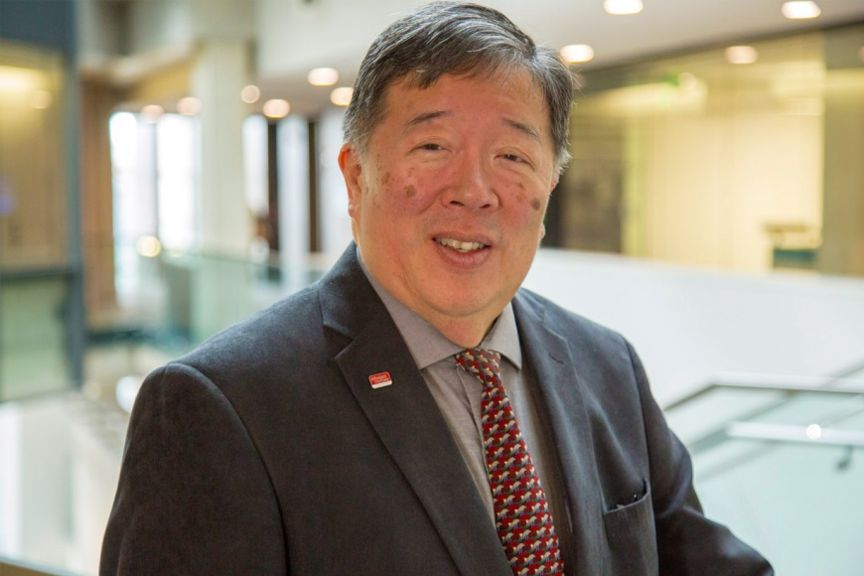
Health Policy PhD Program
Dr. Leighton Ku
Professor, Dept. of Health Policy and Management
Director, Center for Health Policy Research
PhD Health Policy Program Director
lku@gwu.edu

Slide 25
Health Policy PhD Program
A research-oriented PhD program in health policy, health economics and health services research.
Dept of Health Policy & Management is #7 rated health policy dept in US, based in Washington DC.
Collaborate with faculty in other depts and schools (e.g., Public Policy, Nursing)
Multidisciplinary program. Prior Masters or MPH degree. 48 credits.
Typically 2 years of course work, then comprehensive exam, then doctoral candidacy with 2-4 years to complete dissertation.
Publish papers in journals like Health Affairs, Medical Care, AJPH, etc.

Slide 26
Areas of Research
Medicaid & Medicare
Underserved Populations
Health Reform
Health Law & Regulation
Public Health Policy
Workforce Policy
Health Economics Financing
Cost-effectiveness
Health Equity
Recent Dissertation Topics
Social Determinants: MCH Policies
Opioid Use among Medicaid Pregnant Women
Medicaid Expansion Effects on Child & Family Outcomes
Essays on Economics of Community Health Centers
Citizenship & Health

Slide 27
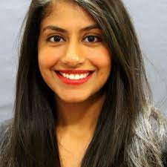
Recent PhD Graduate
Drishti Pillai, PhD, MPH
MPH from Emory. Completed GW dissertation in 2021 on tobacco control policies in Medicaid.
Worked for an immigrant advocacy/ research organization after graduating.
Currently Director, Immigrant Health Policy, Kaiser Family Foundation, Washington, DC.

Slide 28
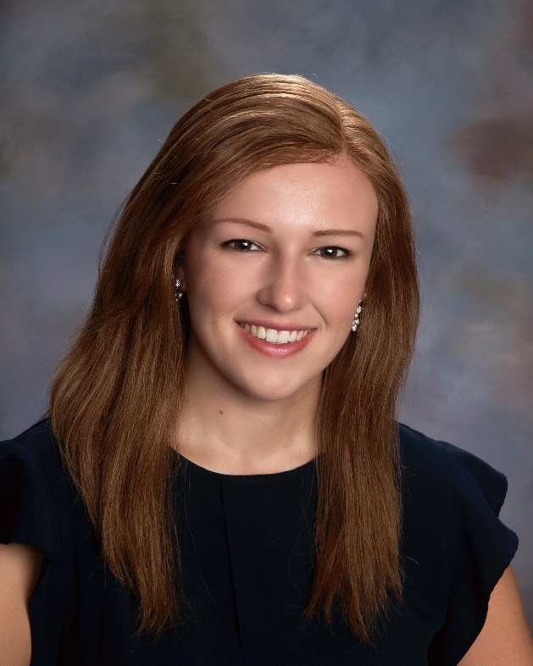
Student Perspective
Lauren O’Connor
PhD Student – Epidemiology

Slide 29
Why PhD?
MPH
PhD
Regression Modeling
Developing Scales
Evaluating Confounding
Selection Bias & Misclassification
Global Health
Health Policy
Designing Health Studies
Health Economics
Biostats
Epidemiology
Model Selection
Non-Parametric Tests
Testing for Effect Modification

Slide 30
Life of a PhD Student (The Fun Part!)
You will learn a LOT
A wide range of research, teaching, and writing opportunities
More time to know faculty and students
More career prospects
Independence in research
All that hard work is fulfilling – especially when it improves public health

Slide 31
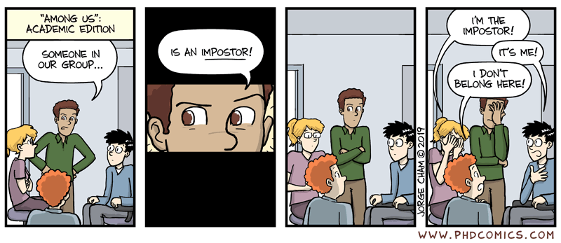
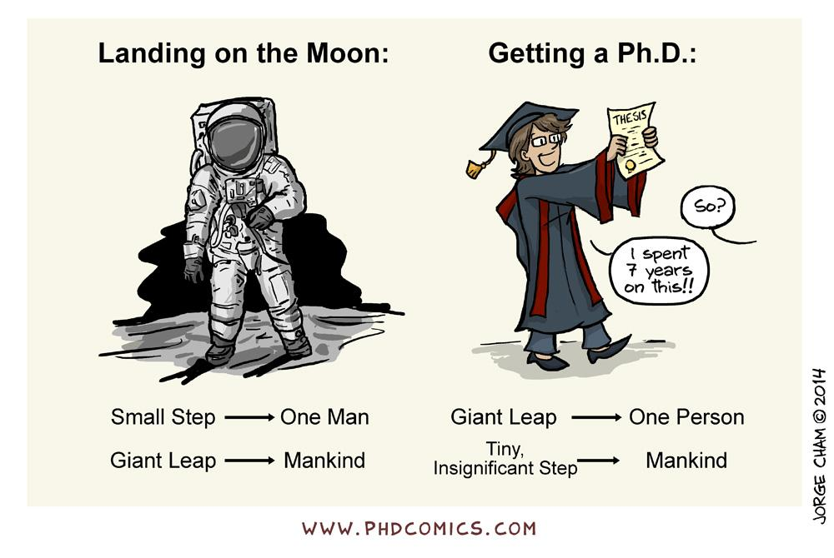
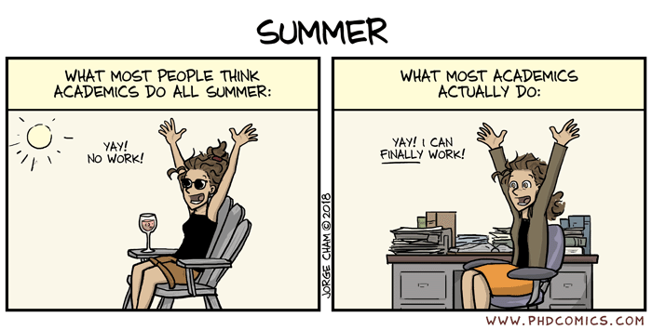
Life of a PhD Student (The Not-so-Fun Part)
A LOT of work – PhD students do not really have “days off”
Imposter Syndrome and burn out is real
PhD takes a lot of time and progress is slow
No full-time salary

Slide 32
So I convinced you to pursue a PhD, now what?
Make a list of potential programs – research, faculty, geography,
stipends, coursework.
Pick at least 3 faculty from each program whose research you’re
interested in.
Reach out to those professors and ask them LOTS of questions –
mention them in your application.

Slide 33
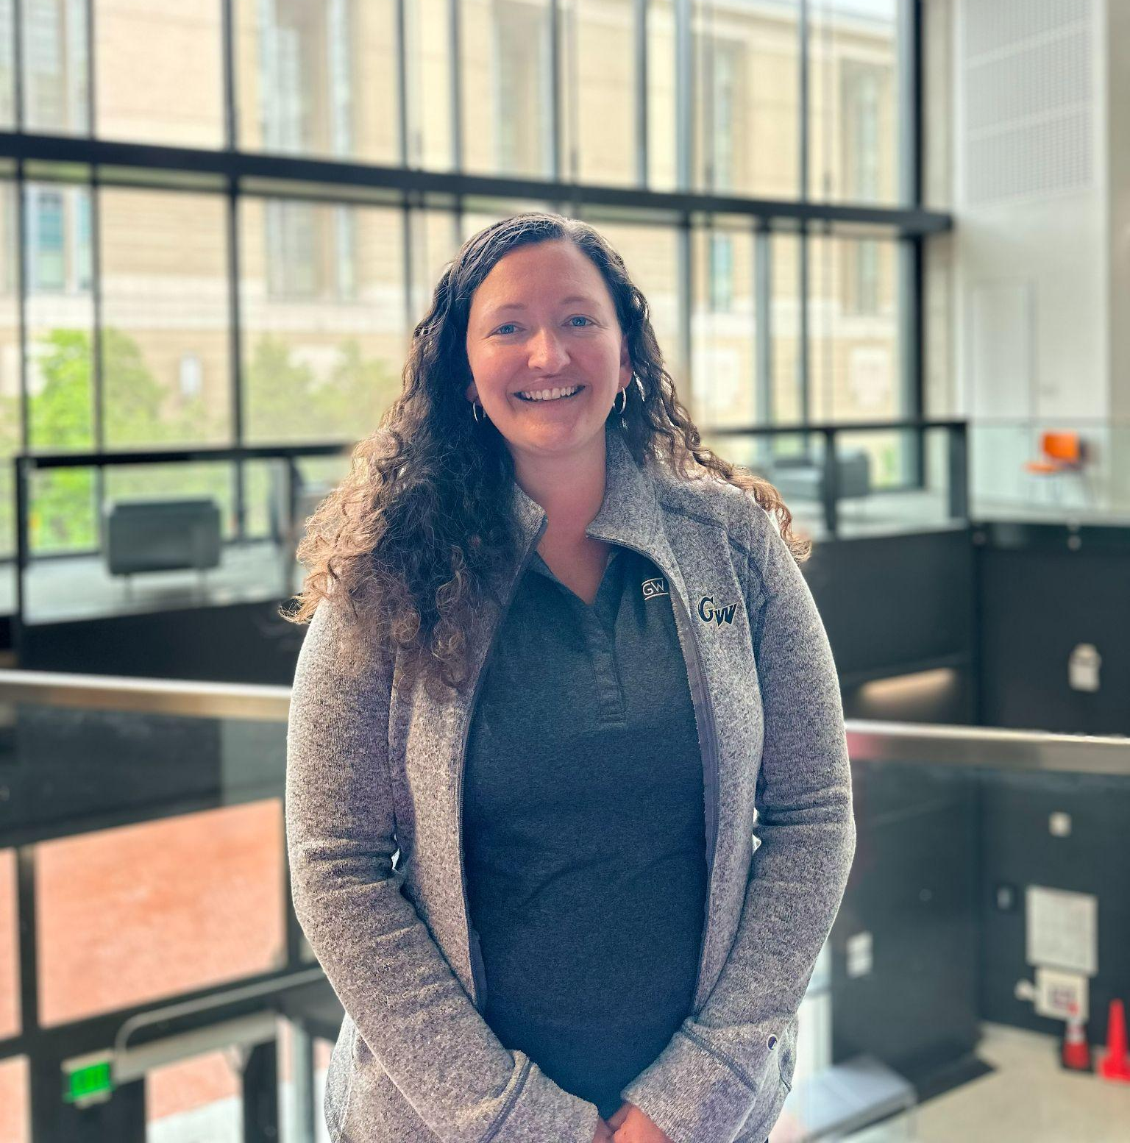
Admissions
Tricia Realbuto
Assistant Director of Admissions
trealbuto@gwu.edu

Slide 34
Application Process
The application portal [sophas.org] will open in mid/ late August 2023 for the Fall 2024 entry term
All application materials must be sent directly to SOPHAS. Materials include:
Official transcripts
Official and valid GRE
Three Letters of Recommendations
Statement of Purpose
Resume or CV
Language proficiency scores*

Slide 35
Application Deadlines
SOPHAS application will open mid-to-late August of 2023.
Doctoral applications must be submitted by Friday, December 1st.
Decisions will be released in February - March 2024.

Slide 36
Connect with us
Virtual Admissions Presentations – offered virtually throughout the year
Individual appointments via zoom, phone or in-person Monday through Friday
Questions? gwsphadmit@gwu.edu

Slide 37
Connect with Office of PhD/MS
OfficePhDMS@gwu.edu
GW Public Health Doctoral Programs
Follow us on:
https://www.facebook.com/GWSPHOfficePhDMS
https://twitter.com/GWSPHPhDMS

Slide 38
GWSPH PhD Programs & Program Directors
1) Health Data Science
Dr. Keith Crandall
Dr. Guoqing Diao
Dr. Toshi Hamasaki
2) Global Public Health Sciences
3) Social and Behavioral Sciences
Dr. Nirbhay Kumar
Dr. Carlos Rodriguez-Diaz

Slide 39
GWSPH PhD Programs & Program Directors
4) Environmental & Occupational Health
5) Epidemiology
Dr. Lance Price
Dr. Kate Applebaum
Dr. Heather Young
6) Health Policy
7) Exercise Physiology
& Applied Nutrition
Dr. Leighton Ku
Dr. Avi Dor
Dr. Jennifer Sacheck

Slide 40
Questions & Discussion

